Slide 1
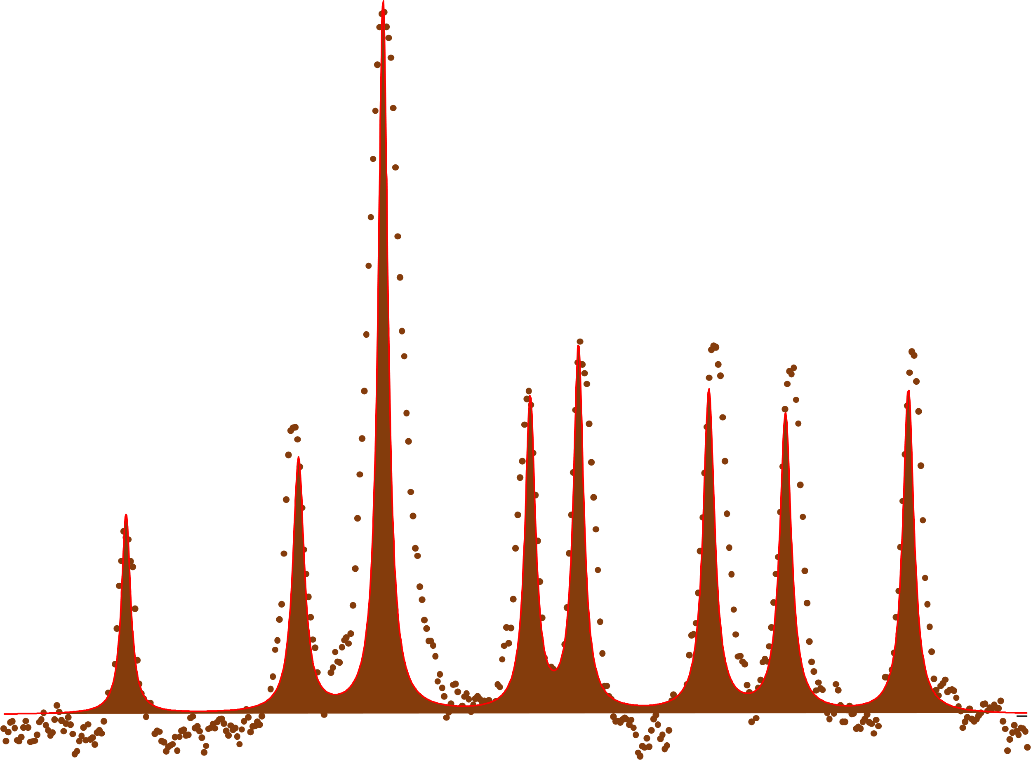
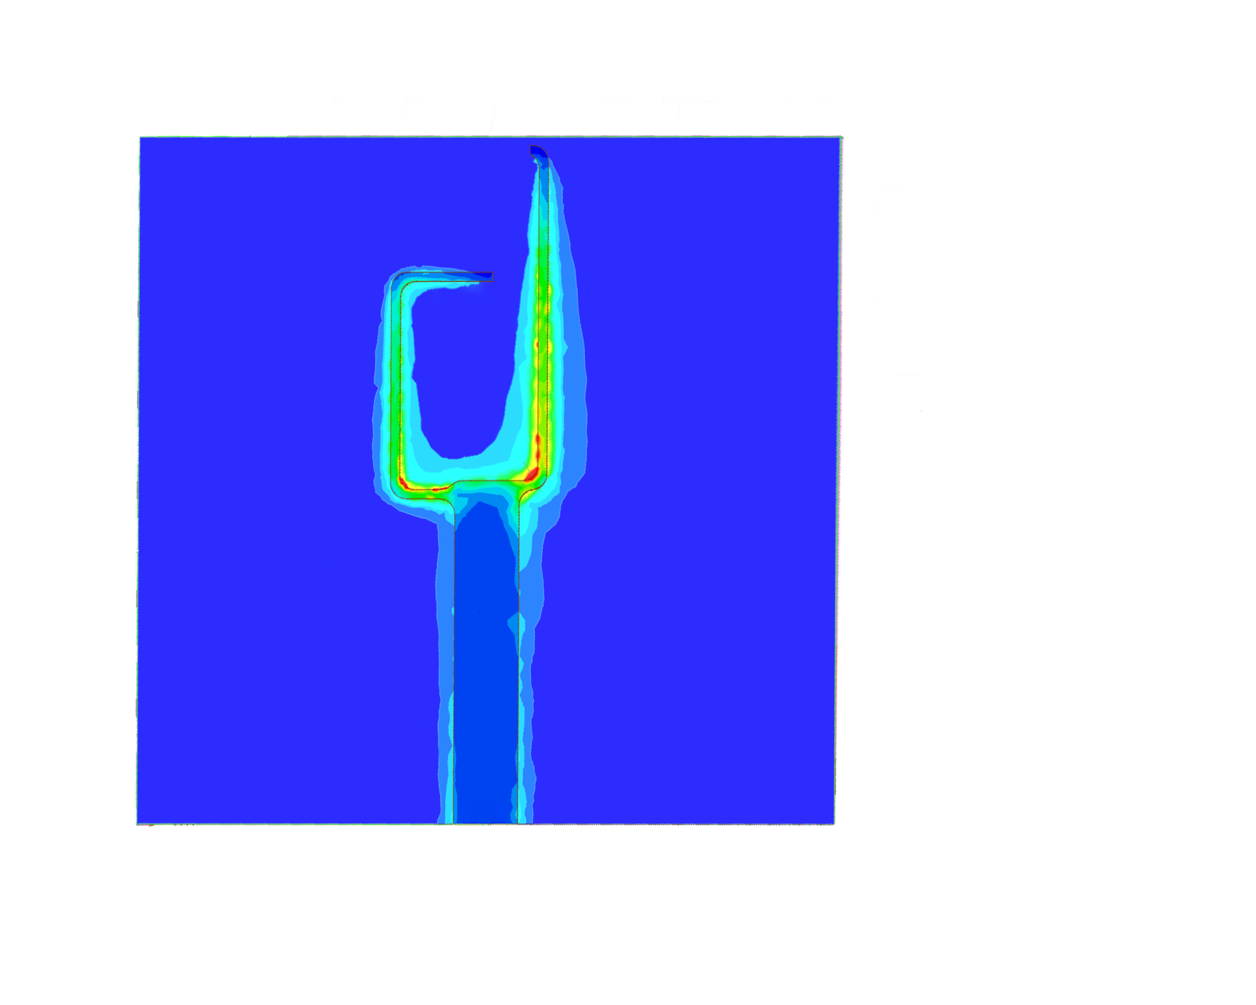
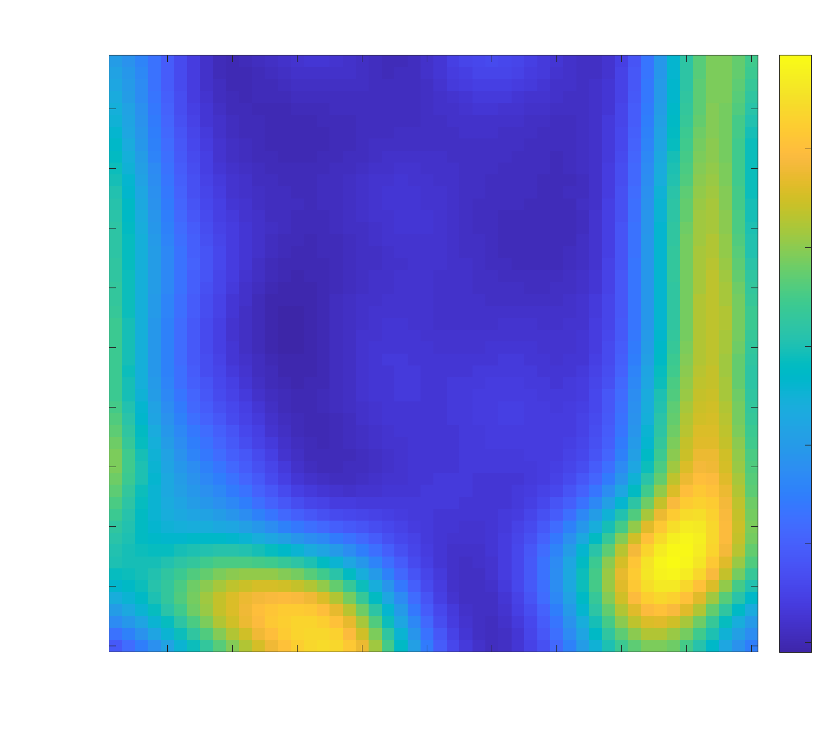
Laser
APD
Obj 2
Tapered fiber
Mirror
Diamond
Filter
DM
Antenna
Spectrum Analyzer
Obj 1
Microwave (2.87 GHz)
Computer
Power AMP
Circulator
Antenna

Slide 2

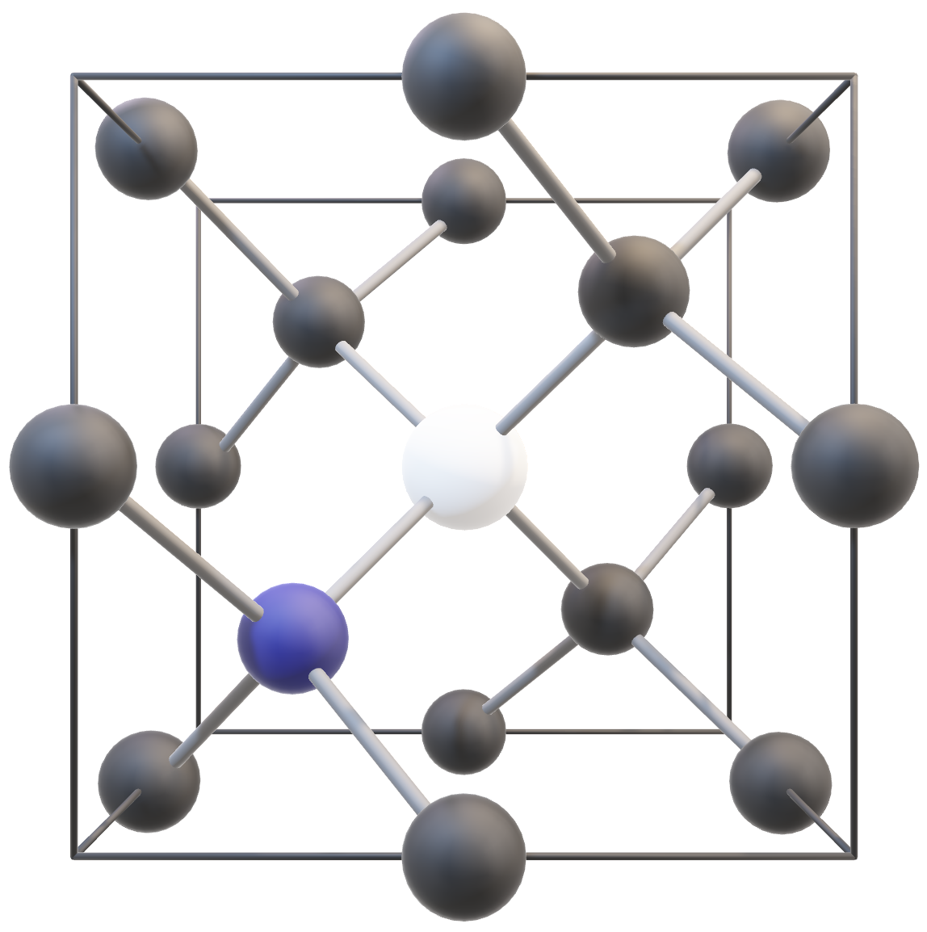




$m_{s}$ =±1
³E
$m_{s}$ = 0
¹E
V
532 nm
¹A₁
532 nm
N
$m_{s}$ =±1
³A₂
2$γB$
$m_{s}$ = 0
2.87 GHz

Slide 3
L₁
L₂
L₃
L
R₁
R₃
W
R₂
a
a
L
b
S

